Slide 1
Halacha and aggadah in the perspective of geopolitical transformation of the 21st century
Bermus Alexander Grigorievich head Department of Education and Pedagogical Sciences of the Federal State Autonomous Educational Institution of Higher Education "Southern Federal University" Doctor of Pedagogy , Professor

Slide 2
PRESENTATION PLAN
1. What are the internal motives for the project?
2. What is the idea of the project? (vision)
3. Who can be participants and stakeholders of the project? ( infrastructure)
4. Possible design of the project?

Slide 3
1. INTERNAL MOTIVES?
What is the meaning for “Hallakha” and “Aggada” for the 21st Century?
Is Talmudic culture/heritage (Pilpul) alive?
Where does Jewish traditions begin, continue and non-stop?
What is the religious tradition in the post-secular World?
What to do if half-Israel wants to be more orthodoxial, and an another half-Israel more free? (how to bring the hatzi-shekel offering for the nowdays)?

Slide 4
2 . PROJECT IDEA
Hallacha: Each Jew wants to observe Mitzvas! (The real problem is DIFFERENT mitzvas for DIFFERENT times need DIFFERENT ways!)
R. Adin Steinsalz: Translation of Talmud into modern Languages + “Introduction to Talmud”
We DO live in the Continuing Jewish Tradition: our descriptions of the World are aggadot, our moral and intellectual search is for hallachot
One of the main problems: “Reality” (aggadot) vs. “Thinking” (hallakhot) in the context of Scripture
Interpretation = Interconnection of R@T, as an interplay of signs
Metaphoric Associative Cards → Talmudic games around events

Slide 5
3. PARTICIPANTS AND STAKEHOLDERS
Humanities|intellectuals – New Practices of Understanding
Politics|leaders – New Ways how to cope with Crisis
New mode for Education – New Path of Thinking and Being

Slide 6
4. POSSIBLE DESIGN
Aggadot (conflict scripts, dramatic cases, situation of misunderstanding) as a starting point.
Halakhot (how to conceive and what to do) is the final Point
Description of cases (participants, observers)
Cards of Talmudic signs (associative generalization – gzira shava; the withdrawing from the last word – davar halamed misofo etc.)
The card play of experts – collective inventing the interpretation
Reconstruction a Hallakha through linearisation and reinforcement of the Oral Tradition
THE RESULTS: A new application of Talmudic instruments as a way to conceiving the actual problems and working out normative exits (at least, fixation of basic alternatives, and clarification of choices)

Slide 7
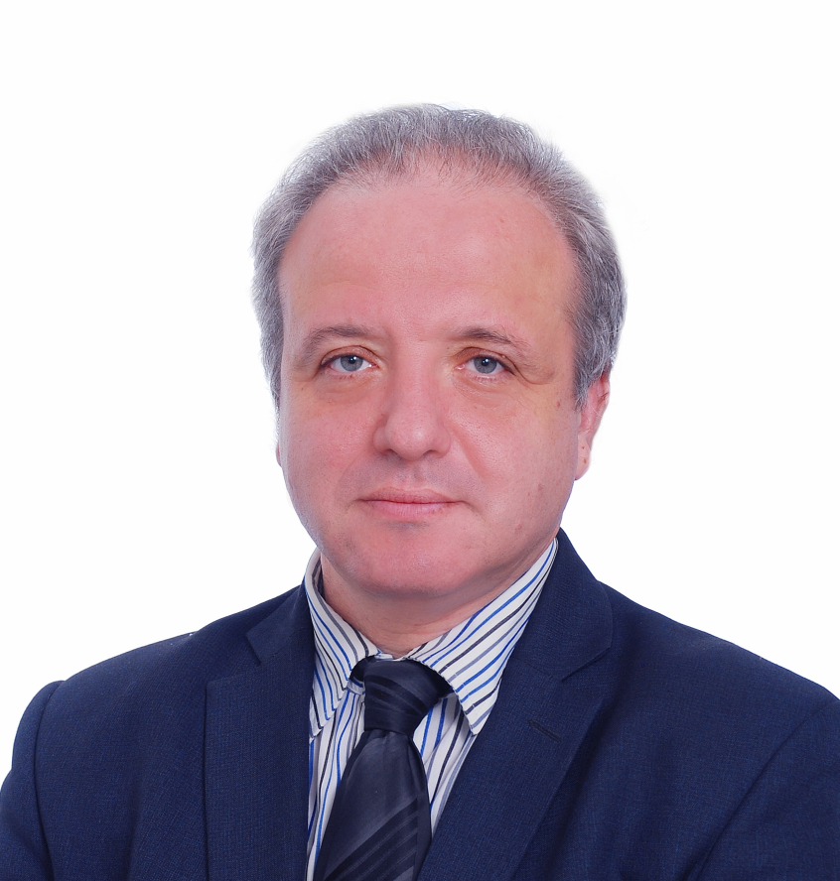
Alexandre Bermous : some excerpts from the CV
Born in 1970
1987 - 1992. Studying at Rostov State University (Department of Physics). Profile in Theoretical Physics (X-ray spectroscopy)
1992 - 1995 . Post-Graduate course at the RSU // Work at the Rostov Regional Institute for the Professional Development of Teachers. Participation in projects for the development of professional qualification tests for teachers; advanced training in the field of solving problems of increased complexity; approbation of the State educational standards of general education.
1995 - 2000 . Work as a preservice teacher at the Rostov State Pedagogical University. Development of programs and methodological support for the training of teachers in the context of a cultural-historical approach ( L.S. Vygotsky )
2000 - 2003. Writing and defending a doctoral dissertation "Quality Management in Teacher Training"
2004 - Research on the principles and strategies for the development of teacher education in a socio-cultural context (“Humanitarian Methodology”)
2005 – Studies of Jewish Traditions, their influence and transformations in the up-to-date world

Slide 8
Thank you for your attention! Bermous Alexandre G. bermous@sfedu.ru Telegram channel: https://t.me/interested _ +79045034018

