Slide 1
Science as Religion
A Critical Outlook at the Scientific Discourse of Hypnosis and
Its Correlation with Religious and Spiritual Phenomena
Marianna Ruah-Midbar Shapiro (Ph.D.)
Zefat Academic College
M.RuahMidbar@Gmail.com

Slide 2
Opening
What is Hypnosis?
Implications of Definition
Socio-Critical Analysis
Hypnosis Science as Religion
Conclusion
Science as Religion
Marianna Ruah-Midbar Shapiro

Slide 3
Opening
What is Hypnosis?
What is Hypnosis?
Implications of Definition
Implications of Definition
Socio-Critical Analysis
Socio-Critical Analysis
Hypnosis Science as Religion
Conclusion
Science as Religion
Marianna Ruah-Midbar Shapiro

Slide 4
Opening
Definitions and Debates
What is Hypnosis?
Implications of Definition
APA Commitees
Socio-Critical Analysis
Hypnosis Science as Religion
Conclusion
A procedure “during which a health professional or researcher suggests that a client, patient, or subject experience changes in sensations, perceptions, thoughts, or behavior.”
“Hypnosis has been used in the treatment of pain, depression, anxiety, stress, habit disorders, and many other psychological and medical problems.”
Science as Religion
Marianna Ruah-Midbar Shapiro

Slide 5
Opening
Definitions and debates
What is Hypnosis?
Implications of Definition
APA Commitees
Socio-Critical Analysis
Hypnosis Science as Religion
Conclusion
“Hypnosis typically involves an introduction to the procedure during which the subject is told that suggestions for imaginative experiences will be presented. The hypnotic induction is an extended initial suggestion for using one’s imagination, and may contain further elaborations of the introduction. A hypnotic procedure is used to encourage and evaluate responses to suggestions. When using hypnosis, one person (the subject) is guided by another (the hypnotist) to respond to suggestions for changes in subjective experience, alterations in perception, sensation, emotion, thought, or behavior. Persons can also learn self-hypnosis, which is the act of administering hypnotic procedures on one’s own. ---”
Science as Religion
Marianna Ruah-Midbar Shapiro

Slide 6
Opening
Definitions and debates
What is Hypnosis?
Implications of Definition
APA Commitees
Socio-Critical Analysis
Hypnosis Science as Religion
Conclusion
“--- If the subject responds to hypnotic suggestions, it is generally inferred that hypnosis has been induced. Many believe that hypnotic responses and experiences are characteristic of a hypnotic state. While some think that it is not necessary to use the word hypnosis as part of the hypnotic induction, others view it as essential.”
Science as Religion
Marianna Ruah-Midbar Shapiro

Slide 7
Opening
Definitions and debates
What is Hypnosis?
Implications of Definition
APA Commitees
Socio-Critical Analysis
Hypnosis Science as Religion
Conclusion
Hypnosis: “A state of consciousness involving focused attention and reduced peripheral awareness characterized by an enhanced capacity for response to suggestion.”
Hypnotic induction: “A procedure designed to induce hypnosis.”
Hypnotizability: “An individual’s ability to experience suggested alterations in physiology, sensations, emotions, thoughts, or behavior during hypnosis.”
Science as Religion
Hypnotherapy: “The use of hypnosis in the treatment of a medical or psychological disorder or concern.”
Marianna Ruah-Midbar Shapiro

Slide 8
Opening
Definitions and debates
What is Hypnosis?
Implications of Definition
APA Commitees
Socio-Critical Analysis
Hypnosis Science as Religion
Conclusion
Science as Religion
Marianna Ruah-Midbar Shapiro

Slide 9
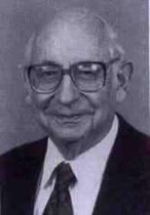
Opening
Definitions and debates
What is Hypnosis?
Implications of Definition
APA Commitees
Socio-Critical Analysis
Hypnosis Science as Religion
Conclusion
No Consensus
André Muller Weitzenhoffer:
Participants in the study were asked to act as if they were hypnotized.
Hypnotherapists could not discern who really was hypnotized
and who was merely acting out.
Science as Religion
Marianna Ruah-Midbar Shapiro

Slide 10
Opening
Definitions and debates
What is Hypnosis?
Implications of Definition
APA Commitees
Socio-Critical Analysis
Hypnosis Science as Religion
Conclusion
No Consensus
Theodore X. Barber:
“Hypnosis” and related constructs are "unnecessary and misleading”
“The phenomena that have been traditionally subsumed under these terms
can be better understood by utilizing a different set of concepts that are
an integral part of present-day psychology.”
Science as Religion
Marianna Ruah-Midbar Shapiro

Slide 11
Opening
Implications
What is Hypnosis?
Implications of Definition
Understanding the human psyche
Therapeutic practices and their implications
States of consciousness which do or do not occur
Socio-Critical Analysis
Hypnosis Science as Religion
For mental health professionals
Conclusion
Hypnotized against one’s will?
Can problems be treated with hypnosis?
A particular kind of training?
For the general public
Legal realm
Science as Religion
Marianna Ruah-Midbar Shapiro

Slide 12
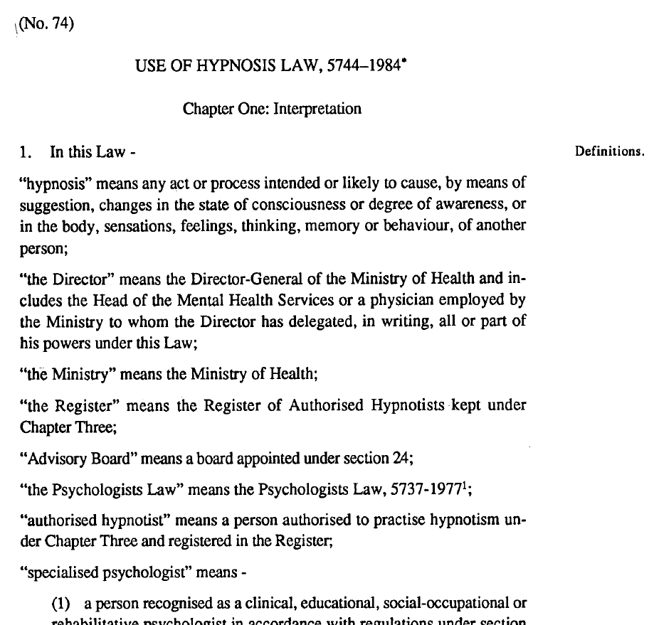
Opening
Implications
➔ Legal realm
What is Hypnosis?
Implications of Definition
Socio-Critical Analysis
Hypnosis Science as Religion
Conclusion
Science as Religion
Marianna Ruah-Midbar Shapiro

Slide 13
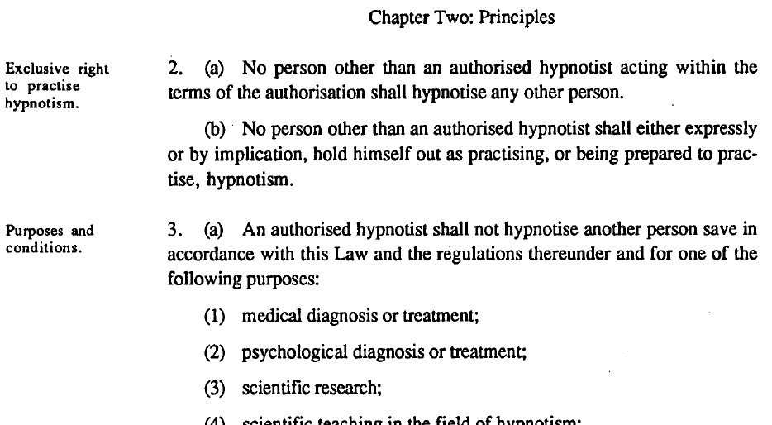
Opening
Implications
➔ Legal realm
What is Hypnosis?
Implications of Definition
Socio-Critical Analysis
Hypnosis Science as Religion
Conclusion
Science as Religion
Marianna Ruah-Midbar Shapiro

Slide 14
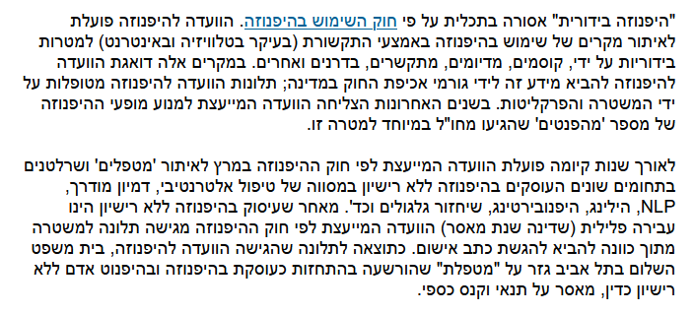
Opening
Implications
➔ Legal realm
What is Hypnosis?
Implications of Definition
Socio-Critical Analysis
Hypnosis Science as Religion
Conclusion
Science as Religion
Marianna Ruah-Midbar Shapiro

Slide 15
Opening
Implications
➔ Legal realm
What is Hypnosis?
Implications of Definition
Socio-Critical Analysis
Hypnosis Science as Religion
Conclusion
Natalie Pick (2012)
Convicted therapist
Nimrod Har’el (2009)
Mentalist
Zachi White (2002)
Magician
Science as Religion
Marianna Ruah-Midbar Shapiro

Slide 16
Opening
Implications
What is Hypnosis?
Implications of Definition
Understanding the human psyche
Therapeutic practices and their implications
States of consciousness which do or do not occur
Socio-Critical Analysis
Hypnosis Science as Religion
For mental health professionals
Conclusion
Hypnotized against one’s will?
Can problems be treated with hypnosis?
A particular kind of training?
For the general public
Legal realm
Therapists, Entertainers
Professional, Personal, and Financial interests
Science as Religion
Marianna Ruah-Midbar Shapiro

Slide 17
Opening
What is Hypnosis?
Scientific/professional discourse as
Permeable to interests, trends, dissemination of ideas
Implications of Definition
Socio-Critical Analysis
Hypnosis Science as Religion
The “truth”? “Hypnosis”? …
Power relations struggle
Conclusion
Rivalry between…
Scientific-Medical
Establishment
Alternative Spiritual
Practitioners
Science as Religion
Marianna Ruah-Midbar Shapiro

Slide 18
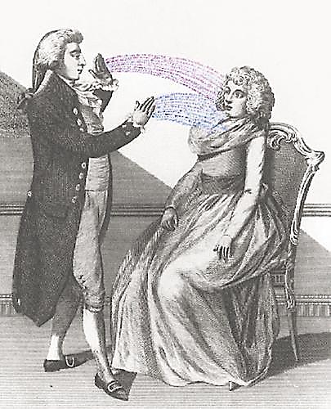
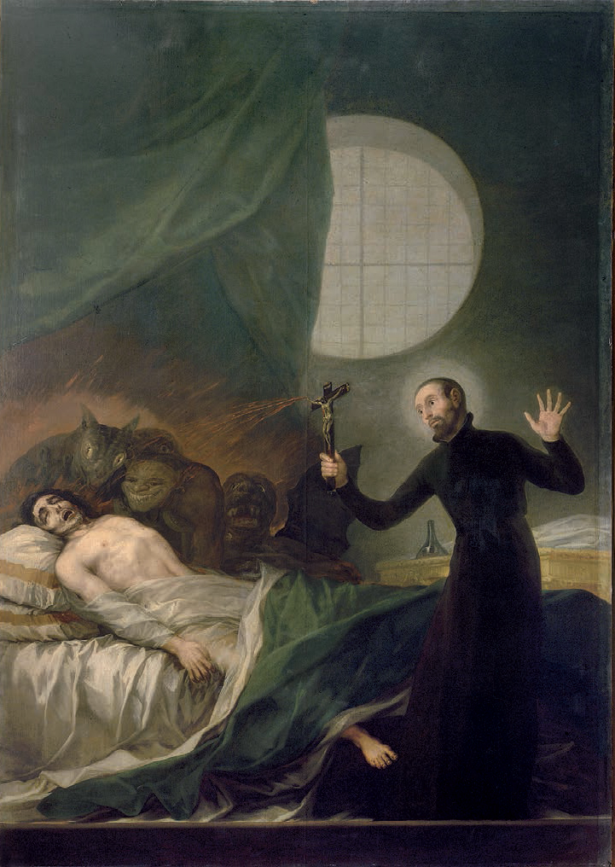
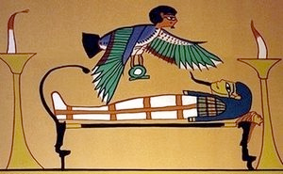
Opening
What is Hypnosis?
Link hypnosis to the religious arena
Implications of Definition
Socio-Critical Analysis
Hypnosis Science as Religion
Conclusion
Science as Religion
Marianna Ruah-Midbar Shapiro

Slide 19
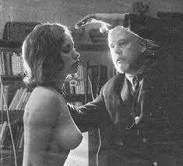
Opening
What is Hypnosis?
Link hypnosis to the religious arena
Implications of Definition
Socio-Critical Analysis
Hypnosis Science as Religion
Conclusion
Science as Religion
Marianna Ruah-Midbar Shapiro

Slide 20
Opening
What is Hypnosis?
Link hypnosis to the religious arena
Implications of Definition
Socio-Critical Analysis
Hypnosis Science as Religion
Religion
Science
versus
Conclusion
Alternatives to Religion
Scientific
Alternative-Spiritual
Inter-religious struggle
Science as Religion
Marianna Ruah-Midbar Shapiro

Slide 21
Opening
What is Hypnosis?
Implications of Definition
Socio-Critical Analysis
Science as player in the cultural arena
Hypnosis Science as Religion
Conclusion
Weakening science’s “truth-claims”
Affinity to religious\magical phenomena
Science as Religion
Science as Religion
Marianna Ruah-Midbar Shapiro

Slide 22
Science as Religion
A Critical Outlook at the Scientific Discourse of Hypnosis and
Its Correlation with Religious and Spiritual Phenomena
Marianna Ruah-Midbar Shapiro (Ph.D.)
Zefat Academic College
M.RuahMidbar@Gmail.com

